Slide 1
Portfolio Optimization using qiskit and Quantum Algorithms

Slide 2
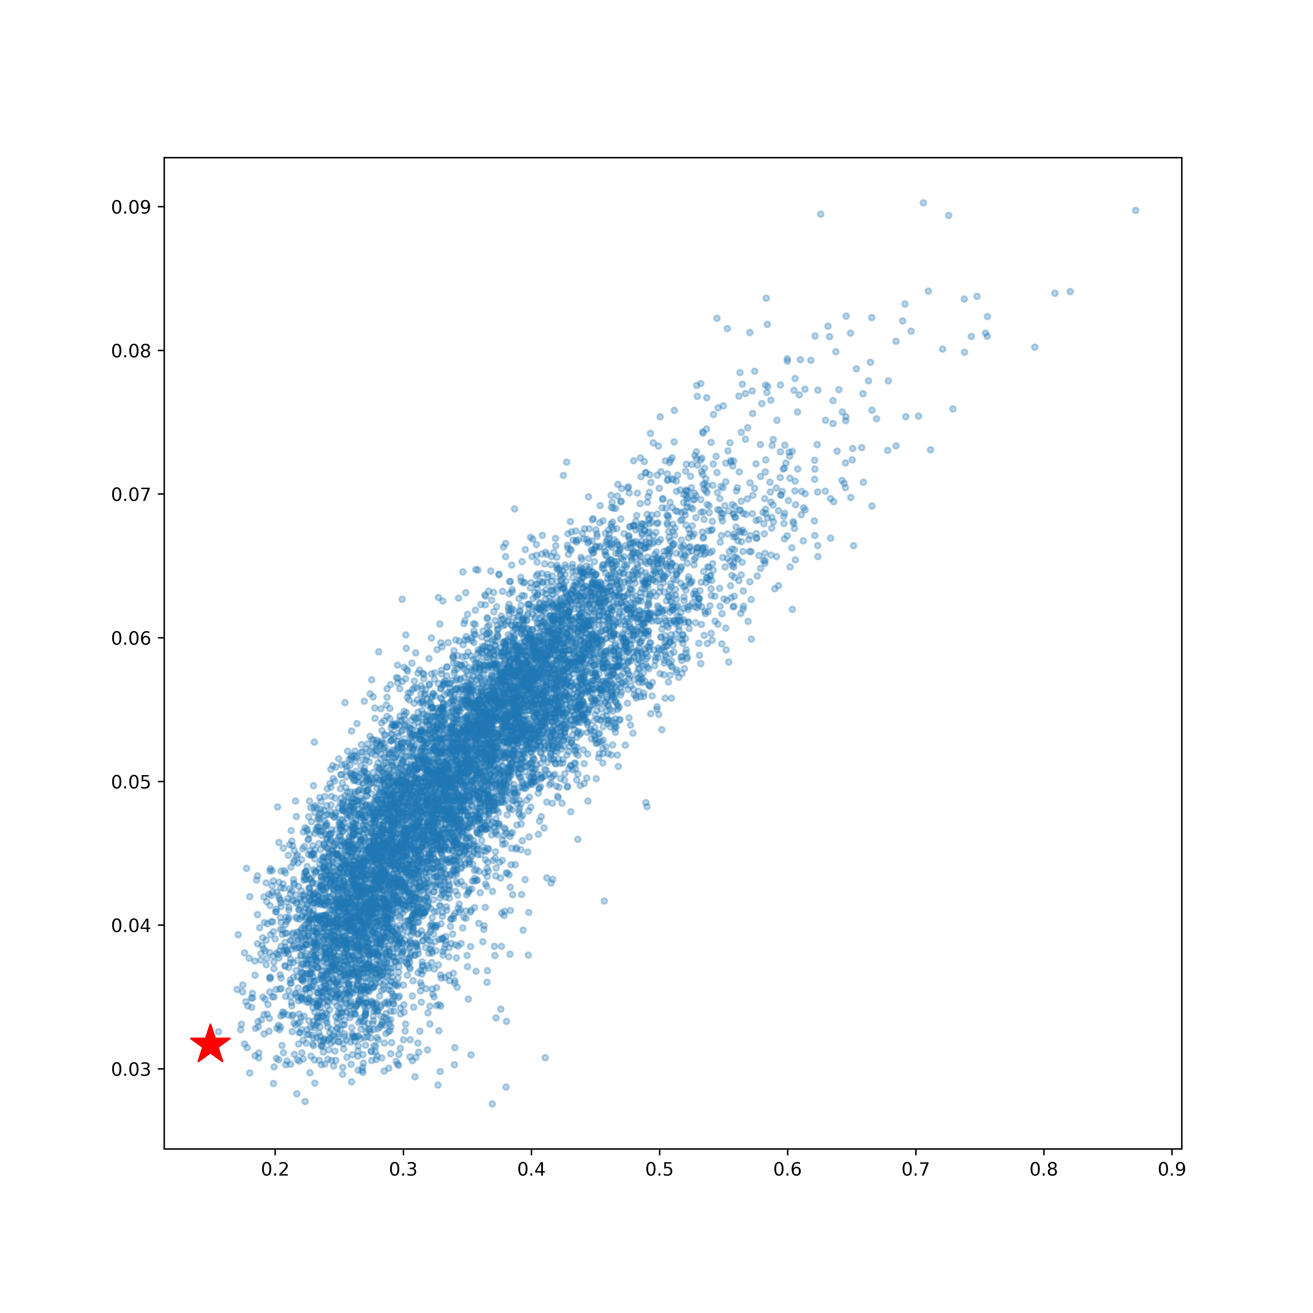
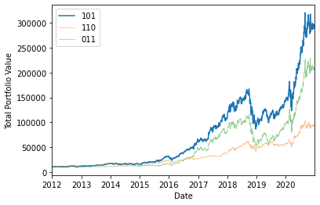
Introduction – Portfolio Optimization
Portfolio Optimization is an active field of research, and is relevant to both individual investors and larger investment groups.
Selecting the best portfolio, according to some objective, can vary significantly in complexity and scale, and can be difficult to compute.
Generally speaking, portfolio optimization is an optimization problem.
Quantum computing lends well to types of optimization problems, and can provide a significant speedup to classical computations.
This allows for more complex problems, using more sophisticated methods to optimize returns.

Slide 3
Introduction – Quantum Computing
Currently, quantum computing hardware is limited by the number of qubits, connectivity, and a number of other factors.
However, even with the current limitations, many problems can be solved with the small-scale hardware, by simulation, or by a combination of classical and quantum techniques.
Among these techniques are two extremely promising algorithms, the Variational Quantum Eigensolver (VQE) and the Quantum Approximate Optimization Algorithm (QAOA) respectively.

Slide 4
Introduction – Quantum Portfolio Optimization
To this end, we can showcase the current algorithms and their capabilities for applied problems at the present moment.
We can also describe these problems in the context of the evolution of quantum computing, and noting where there are benefits to be had as the hardware evolves.
The problem we will explore is a portfolio optimization problem, and solving it
Classically,
With the Variational Quantum Eigensolver Algorithm,
And with the Quantum Approximation Optimization Algorithm,
all using what is available through qiskit.

Slide 5
Portfolio Optimization Problem

Slide 6
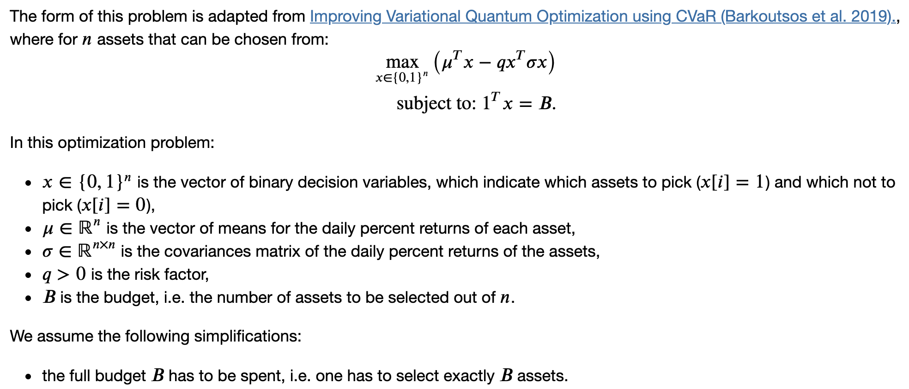
Portfolio Optimization Problem
Need to define the problem in an amenable way.

Slide 7
Variational Quantum Eigensolver

Slide 8
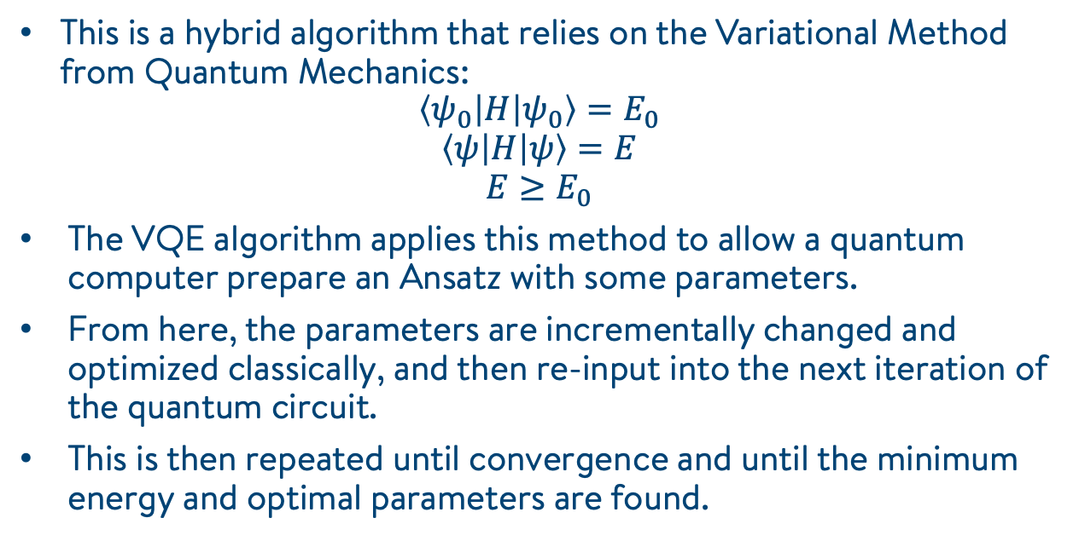
Variational Quantum Eigensolver
This is a hybrid algorithm that relies on the Variational Method from Quantum Mechanics:
$$\left\langle ψ_{0} | H | ψ_{0}\right\rangle =E_{0}$$
$$\left\langle ψ | H | ψ\right\rangle =E$$
$$E≥E_{0}$$
The VQE algorithm applies this method to allow a quantum computer prepare an Ansatz with some parameters.
From here, the parameters are incrementally changed and optimized classically, and then re-input into the next iteration of the quantum circuit.
This is then repeated until convergence and until the minimum energy and optimal parameters are found.

Slide 9
Variational Quantum Eigensolver
Prepare Parametrized State (Ansatz)
Compute Energy Using a Quantum Circuit
Use a Classical Optimizer to Find Better Parameters

Slide 10
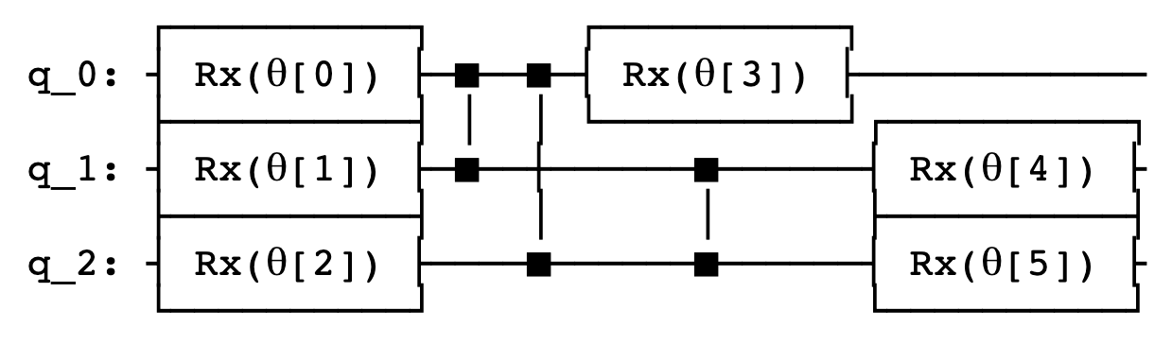
Variational Quantum Eigensolver
The choice of Ansatz dictates the accuracy of your results, and the efficiency of your algorithm.
The choice is limited by hardware capabilities.

Slide 11
Quantum Approximation Optimization Algorithm

Slide 12
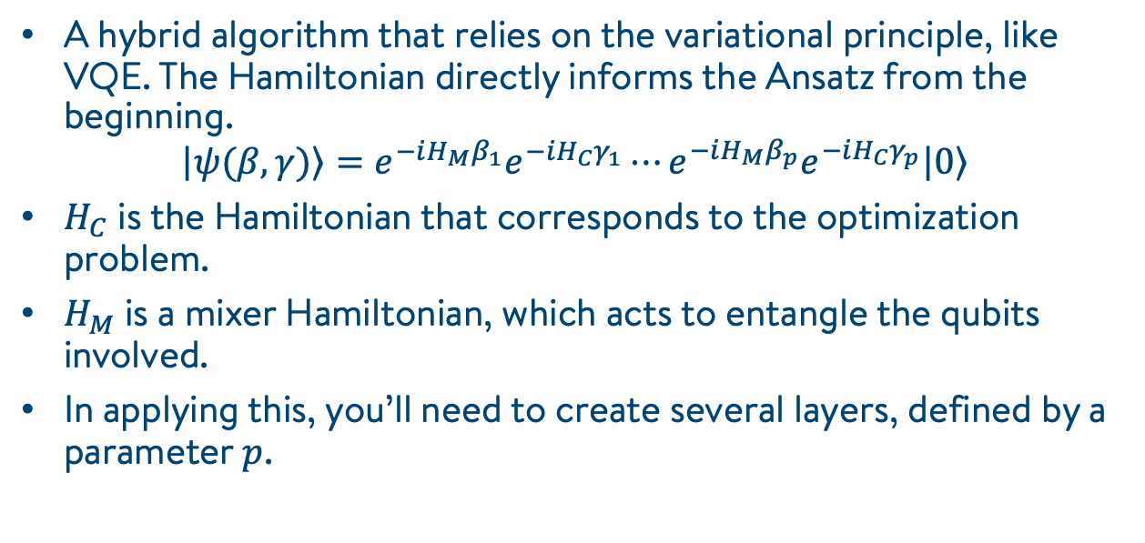
Quantum Approximation Optimization Algorithm
A hybrid algorithm that relies on the variational principle, like VQE. The Hamiltonian directly informs the Ansatz from the beginning.
$$\left.\left|ψ(β,γ)\right.\right\rangle =e^{−iH_{M}β_{1}}e^{−iH_{C}γ_{1}}⋯e^{−iH_{M}β_{p}}e^{−iH_{C}γ_{p}}\left.\left|0\right.\right\rangle$$
$H_{C}$ is the Hamiltonian that corresponds to the optimization problem.
$H_{M}$ is a mixer Hamiltonian, which acts to entangle the qubits involved.
In applying this, you’ll need to create several layers, defined by a parameter $p$.

Slide 13
Some Results

Slide 14
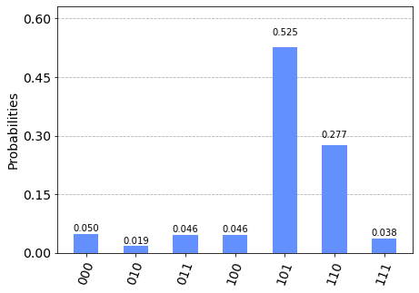
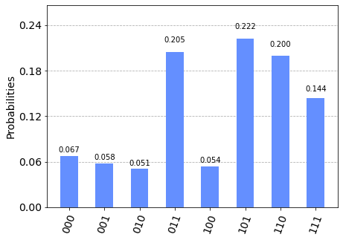
Results
VQE
QAOA

Slide 15
The Academic Collaboration in Finance Program
For more information, email: andrew.milne@1qbit.com, anish.verma@1qbit.com

Slide 16
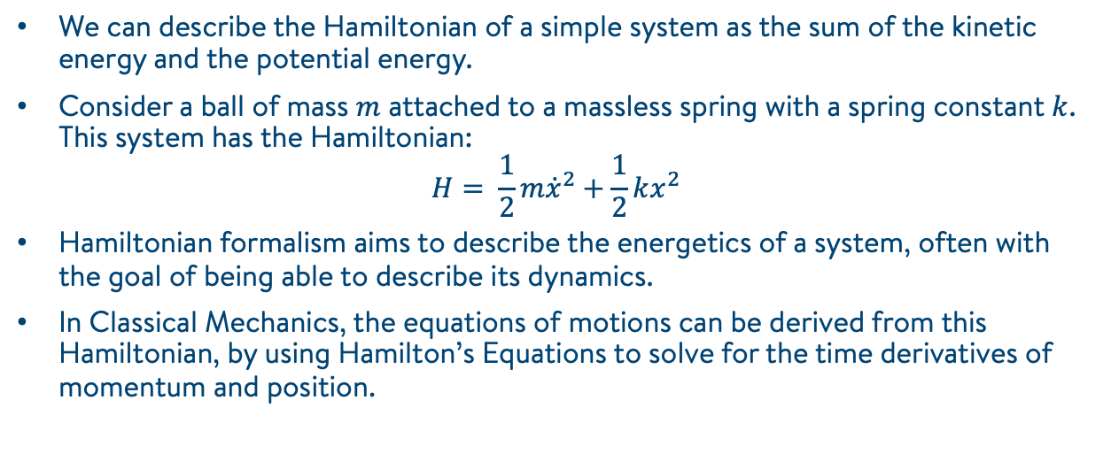
Hamiltonian: From Classical …
We can describe the Hamiltonian of a simple system as the sum of the kinetic energy and the potential energy.
Consider a ball of mass $m$ attached to a massless spring with a spring constant $k$. This system has the Hamiltonian:
$$H= \frac{1}{2}m{\dot{x}}^{2}+\frac{1}{2}kx^{2}$$
Hamiltonian formalism aims to describe the energetics of a system, often with the goal of being able to describe its dynamics.
In Classical Mechanics, the equations of motions can be derived from this Hamiltonian, by using Hamilton’s Equations to solve for the time derivatives of momentum and position.

Slide 17
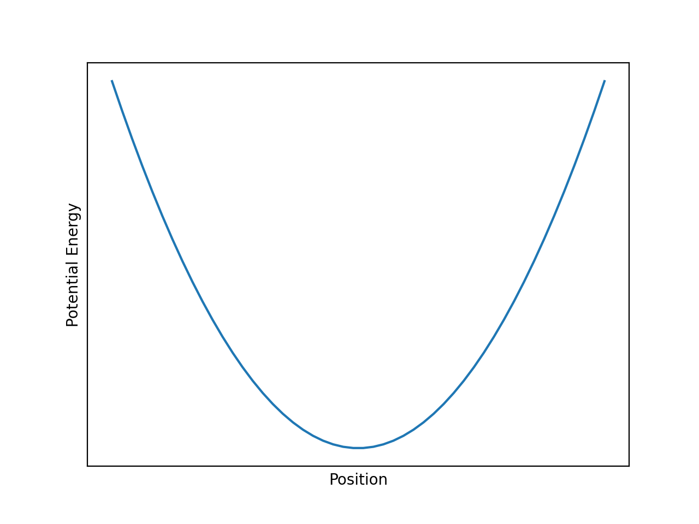
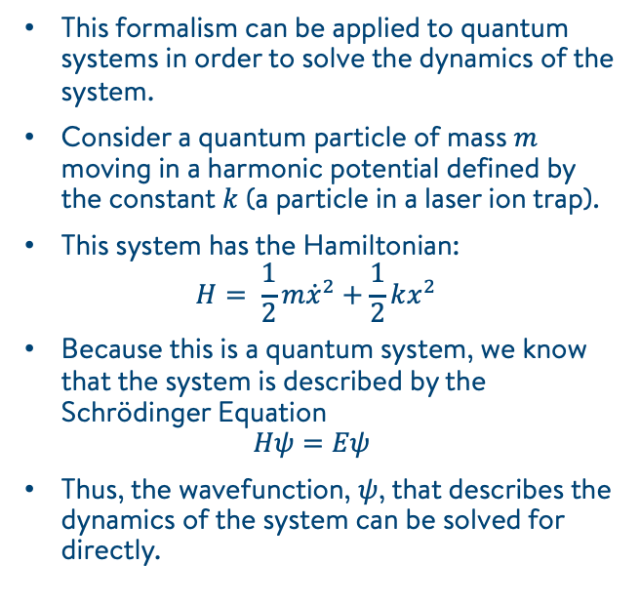
Hamiltonian: From Classical to Quantum
This formalism can be applied to quantum systems in order to solve the dynamics of the system.
Consider a quantum particle of mass $m$ moving in a harmonic potential defined by the constant $k$ (a particle in a laser ion trap).
This system has the Hamiltonian:
$$H= \frac{1}{2}m{\dot{x}}^{2}+\frac{1}{2}kx^{2}$$
Because this is a quantum system, we know that the system is described by the Schrödinger Equation
$$Hψ=Eψ$$
Thus, the wavefunction, $ψ$, that describes the dynamics of the system can be solved for directly.
The potential that the quantum particle occupies.

Slide 18
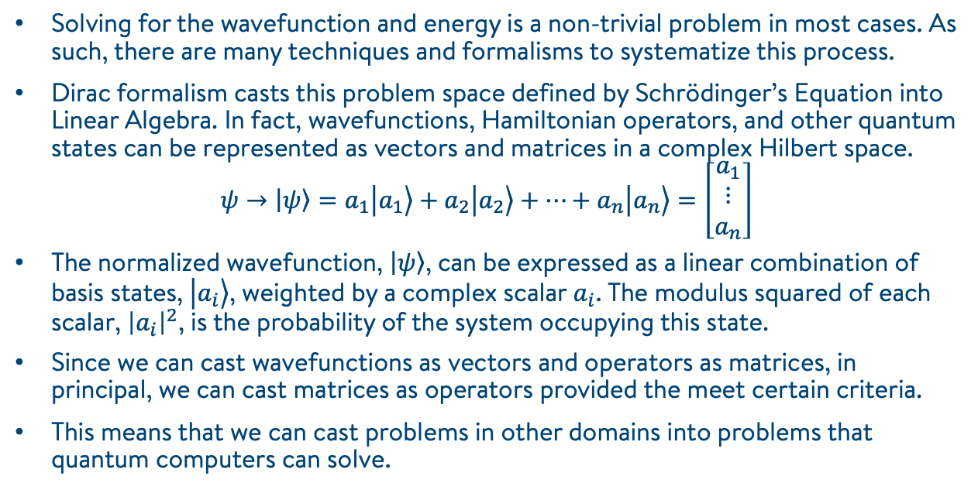
Dirac Formalism (Bra-Ket Notation)
Solving for the wavefunction and energy is a non-trivial problem in most cases. As such, there are many techniques and formalisms to systematize this process.
Dirac formalism casts this problem space defined by Schrödinger’s Equation into Linear Algebra. In fact, wavefunctions, Hamiltonian operators, and other quantum states can be represented as vectors and matrices in a complex Hilbert space.
$$ψ→\left.\left|ψ\right.\right\rangle =a_{1}\left.\left|a_{1}\right.\right\rangle +a_{2}\left.\left|a_{2}\right.\right\rangle +⋯+a_{n}\left.\left|a_{n}\right.\right\rangle =\left[\begin{matrix}a_{1} \\ ⋮ \\ a_{n}\end{matrix}\right]$$
The normalized wavefunction, $\left.\left|ψ\right.\right\rangle$, can be expressed as a linear combination of basis states, $\left.\left|a_{i}\right.\right\rangle$, weighted by a complex scalar $a_{i}$. The modulus squared of each scalar, ${\left|a_{i}\right|}^{2}$, is the probability of the system occupying this state.
Since we can cast wavefunctions as vectors and operators as matrices, in principal, we can cast matrices as operators provided the meet certain criteria.
This means that we can cast problems in other domains into problems that quantum computers can solve.

